Slide 1
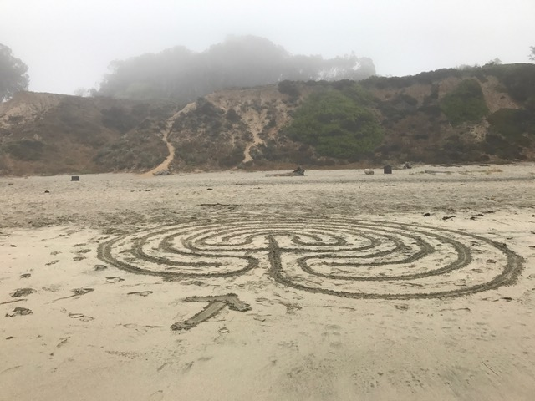
PATTERNS AND PATHWAYS
BRIGHID FITZGIBBON
VERIDITAS
JULY 23, 2021

Slide 3
Languishing
an emptiness or dissatisfaction in day-to-day life
feeling stuck in weariness or stagnation

Slide 7
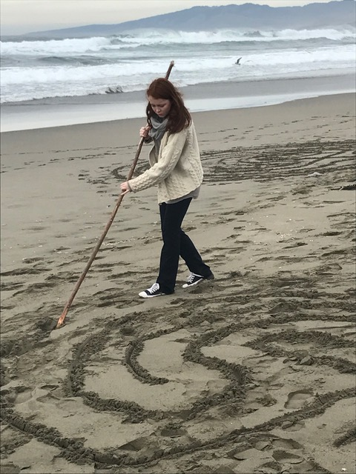
Creating Pathways
Take care of your body physically.
Cultivate the positive emotions (pride, nurturant love, contentment, nostalgia, flow, gratitude and awe) that you would like to have in the future.

Slide 8
Patterns & Pathways
Share some appreciation
Take an “awe walk”
Listen to a “calm concert”

Slide 9
The Distance Between Us
The distance between us is holy ground to be traversed feet bare hands raised in joyous dance so that once it is crossed the tracks of our pilgrimage shine in the darkness & light our coming together in a bright & steady light. Rafael Jesús González, 2011

Slide 10
Today’s Resources
https://www.npr.org/sections/health-shots/2021/06/29/1010319240/stuck-in-a-rut-sometimes-joy-takes-a-little-practice
https://music.apple.com/us/album/woodland-stream-babbling-water-and-relaxing-bird-song/326223207?i=326223566
González Raphael Jesús. “The Distance Between Us.” 2011.

