Slide 1
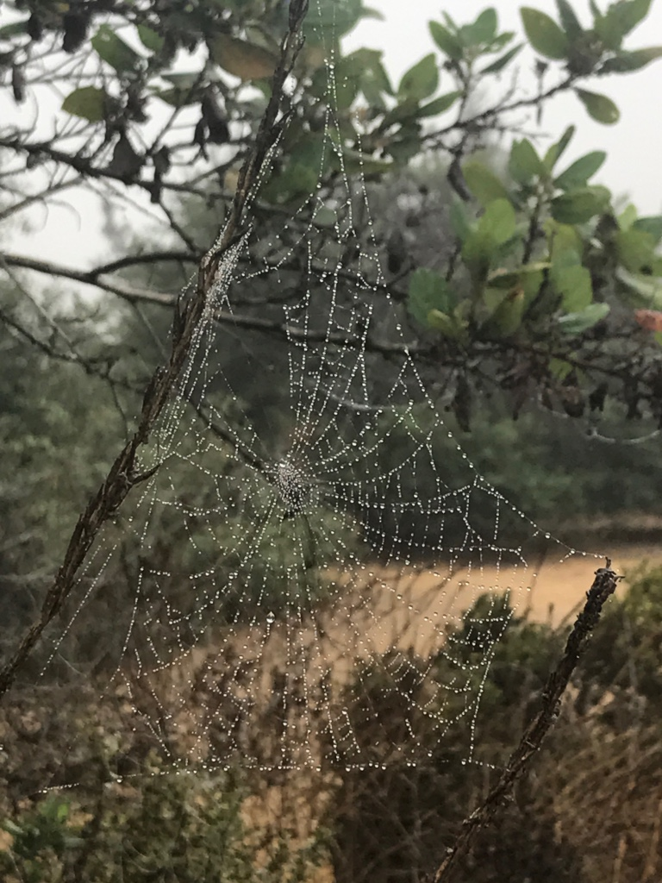
Walking with our Ancestors
November 27, 2020
Brighid Fitzgibbon

Slide 2
Breathing in, I see all my ancestors in me: my mineral ancestors, plant ancestors, mammal ancestors, and human ancestors. My ancestors are always present, alive in every cell of my body, and I play a part in their immortality.
-Thich Nhat Hanh

Slide 3
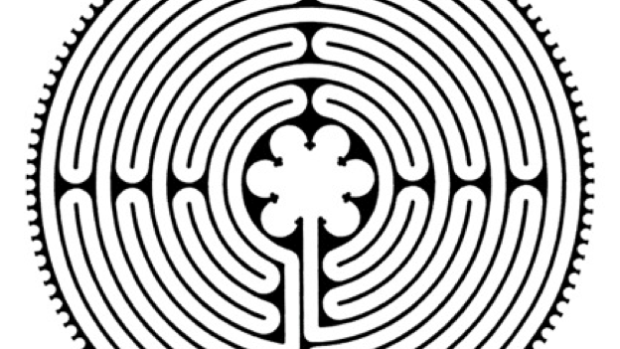
The Web of Life Embedded Within the Center of the Chartres Labyrinth
Animal
Human
Plant
Angelic
Great
Mystery
Mineral
This Photo by Unknown Author is licensed under CC BY-SA

Slide 4
In order to be born, you needed
2 parents
4 grandparents
8 great-grandparents
16 second great-grandparents
32 third great-grandparents
128 fifth great-grandparents
256 sixth great-grandparents
512 seventh great-grandparents
1,024 eighth great-grandparents
2,048 ninth great-grandparents

Slide 5
For you to be born today from 12 previous generations, you needed a total of
4,094 ancestors over the last 400 years.
How many struggles?
How many difficulties?
How much happiness?
How many love stories?
How many expressions of hope for the future?

Slide 6
Walking, I am listening to a deeper way.
Walking, I am listening to a deeper way.
Suddenly all my ancestors are behind me.
Be still they say.
Watch and listen.
You are the result of the love of thousands.
-Linda Hogan

Slide 7
The Map You Make Yourself
You have looked at so many doors with longing,
Wondering if your life lay on the other side.
For today, choose the door that opens to the inside.
Travel the most ancient way of all:
The path that leads to the center of your life.
No map but the one you make yourself.

Slide 8
The Map You Make Yourself
No provision but what you already carry
And the grace that comes to those who walk the pilgrim’s way.
Speak this blessing as you set out
And watch how your rhythm slows,
The cadence of the road drawing you into the pace that is your own.
Eat when hungry. Rest when tired. Listen to your dreaming.
Welcome detours as doors deeper in.
Pray for protection. Ask for guidance. Offer gladness for the gifts that
Come, and then let them go.

Slide 9
The Map You Make Yourself
Do not expect to return by the same road.
Home is always by another way, and you will know it
Not by the light that waits for you
But by the start that blazes inside you,
Telling you where you are is holy
And you are welcome here.
-Jan Richardson

Slide 10
Today’s music
Diana Stork and Portia Diwa. “Music from the Labyrinth,” Music of the Labyrinth: From Chartres to Grace. 2016.

